Slide 1
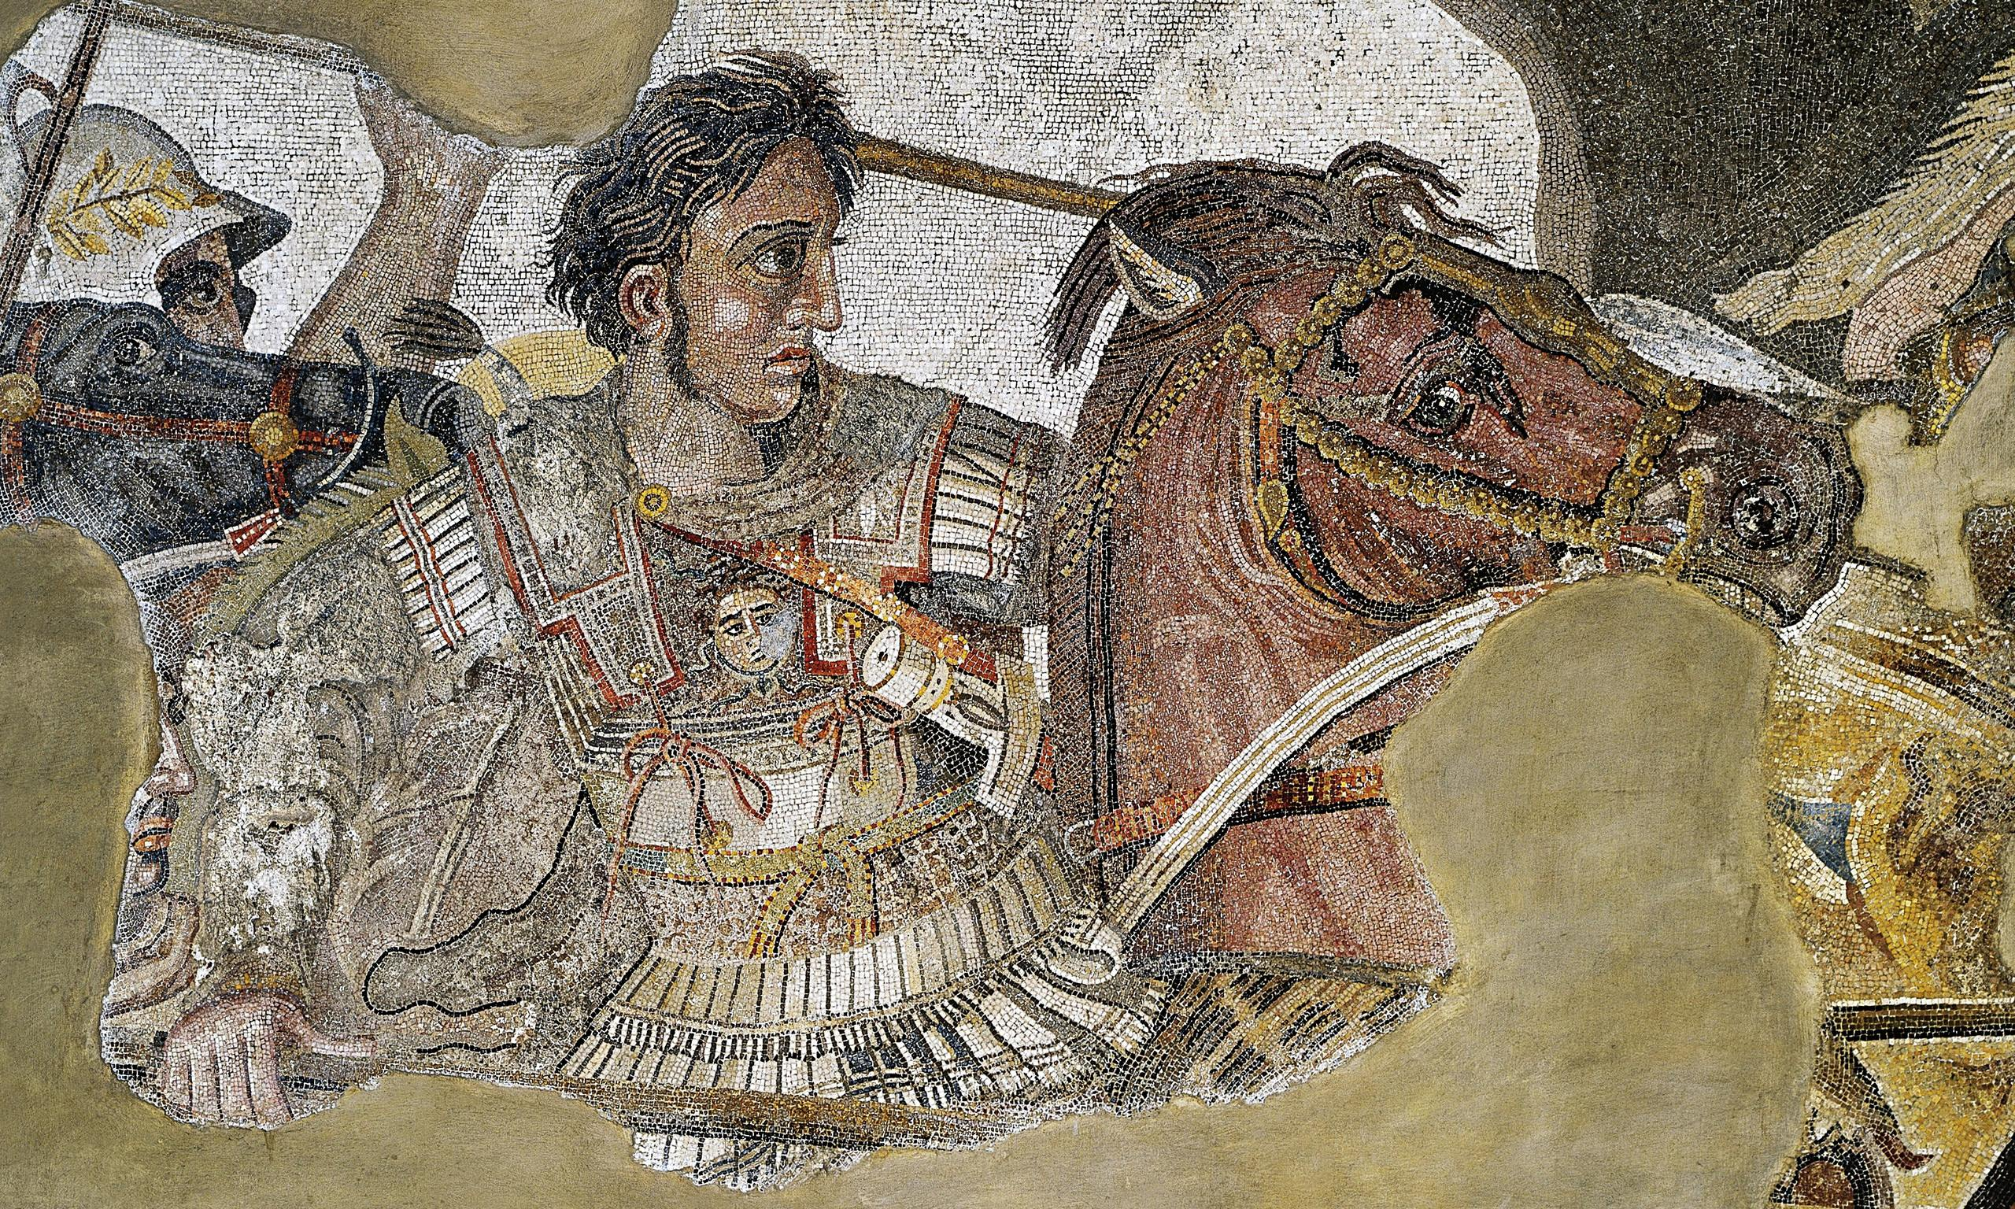
Gaugamela and Persia
Goal/s:
Research the battle of Gaugamela against persia
Week 10 Lesson 5 – unit 2
Ms Barrie

Slide 2
In 331 BCE, Alexander the Great led his army into Persia in an attempt to conquer the empire. The Persians were no match for Alexander and his well-trained forces, and they were quickly defeated in battle after battle. The most significant victory for Alexander was at Gaugamela, where he faced off against Darius III, the Persian king. The Battle of Gaugamela took place on October 1st, 331 BCE near the city of Arbil in modern-day Iraq. This was the final battle between Alexander and Darius III, and it resulted in a decisive victory for Alexander.

Slide 3
ACTIVITY – Research Task
Use the booklet provided and a laptop to complete the research task.
Follow the instructions to research Alexander’s involvement in the Battle of Gaugamela against Darius III and the Persian forces.
Must be completed by the end of the lesson.

